Slide 1

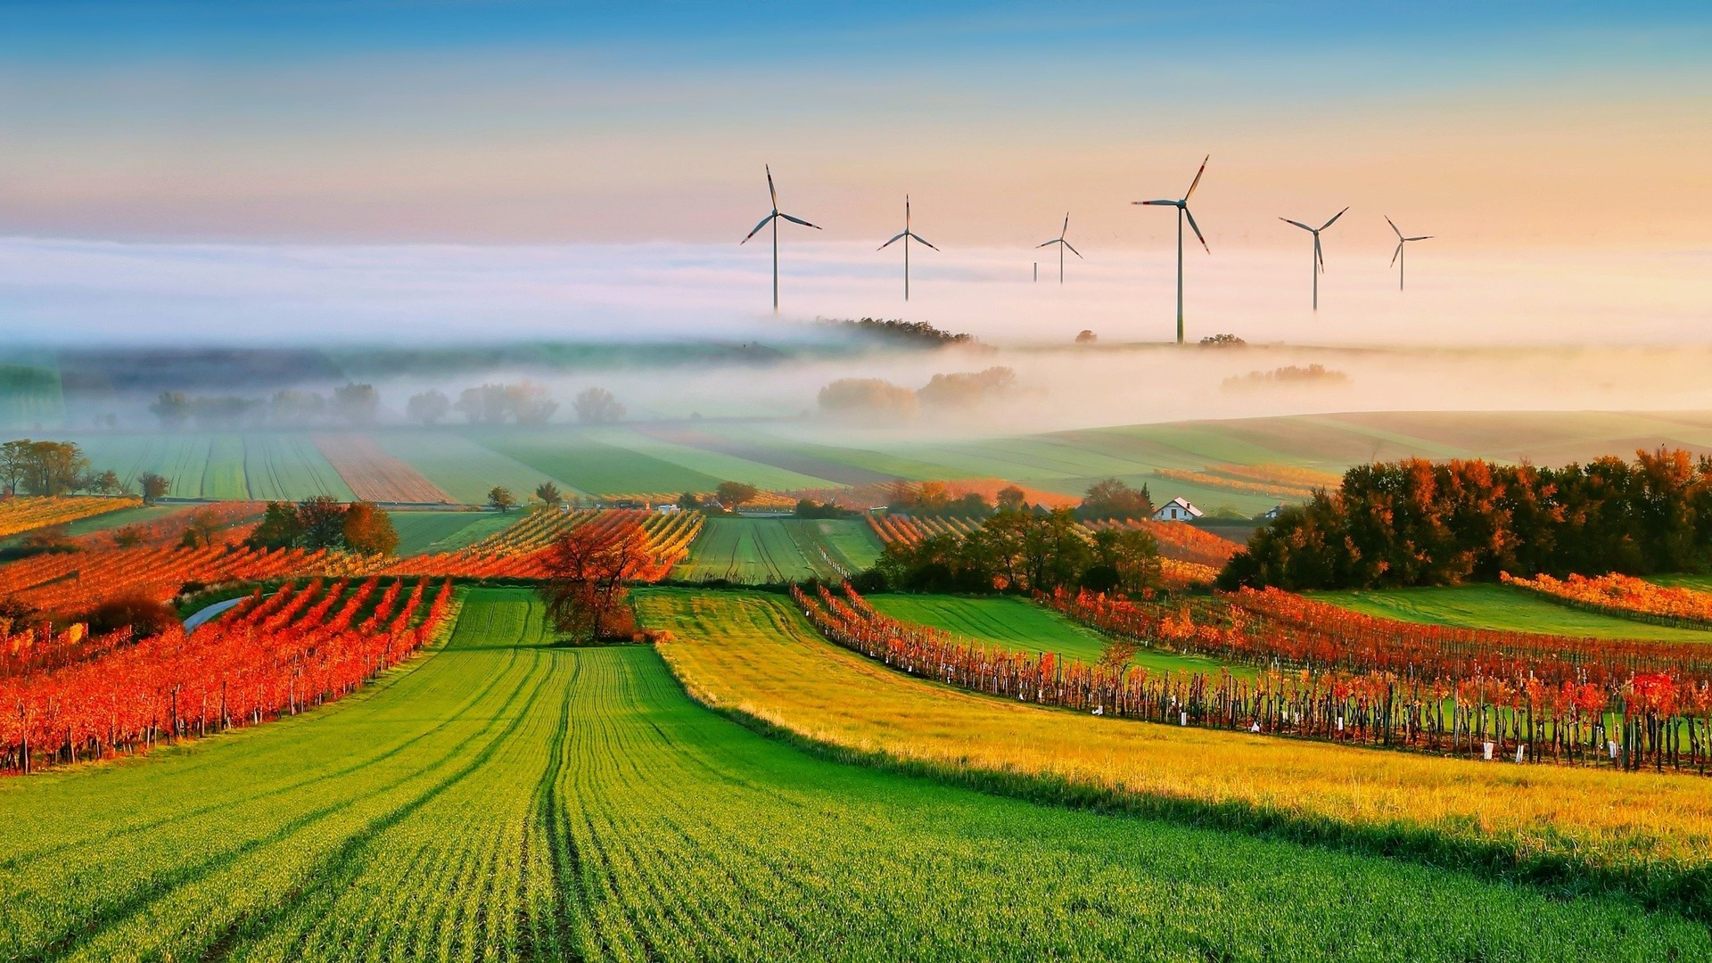
DASSICO - DAta Storing and Structuring for Information Discovery in AgTech
Dimas Satria 21 November 2019
Department of Mathematics and Computer Science

Slide 2

Agenda
Context
Project Goal
Design
Implementation
Project Management
Conclusions

Slide 3

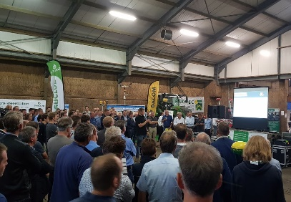
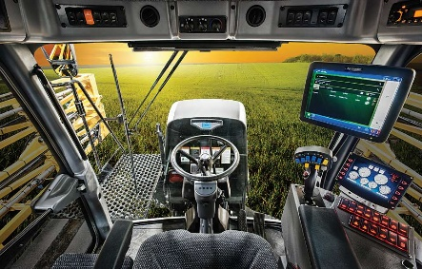
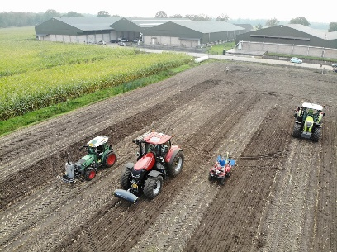
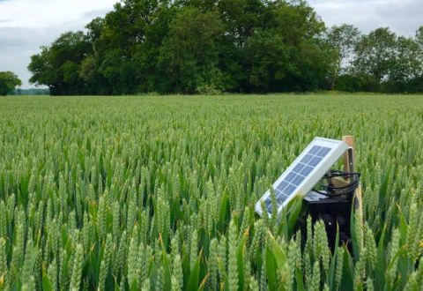
Develop and operate a testing ground for precision agriculture in order to accelerate innovation and the adoption of precision agriculture in the Netherlands.
The goal of Proeftuin voor Precisielandbouw¹:
Develop and operate a testing ground in order to accelerate innovation and the adoption of Precision Agriculture concept in The Netherlands
¹ https://www.pcvpl.nl/nl/project-doelstelling

Slide 4
The Customer’s Need
“Proeftuin voor Precisielandbouw needs
a data storage for information discovery in Precision Agriculture”
Notes:
The scope of the system in this project:
Handle manual and automated sensing data

Slide 5

“… data storage for information discovery
in Precision Agriculture”
What is Precision Agriculture?

Slide 6
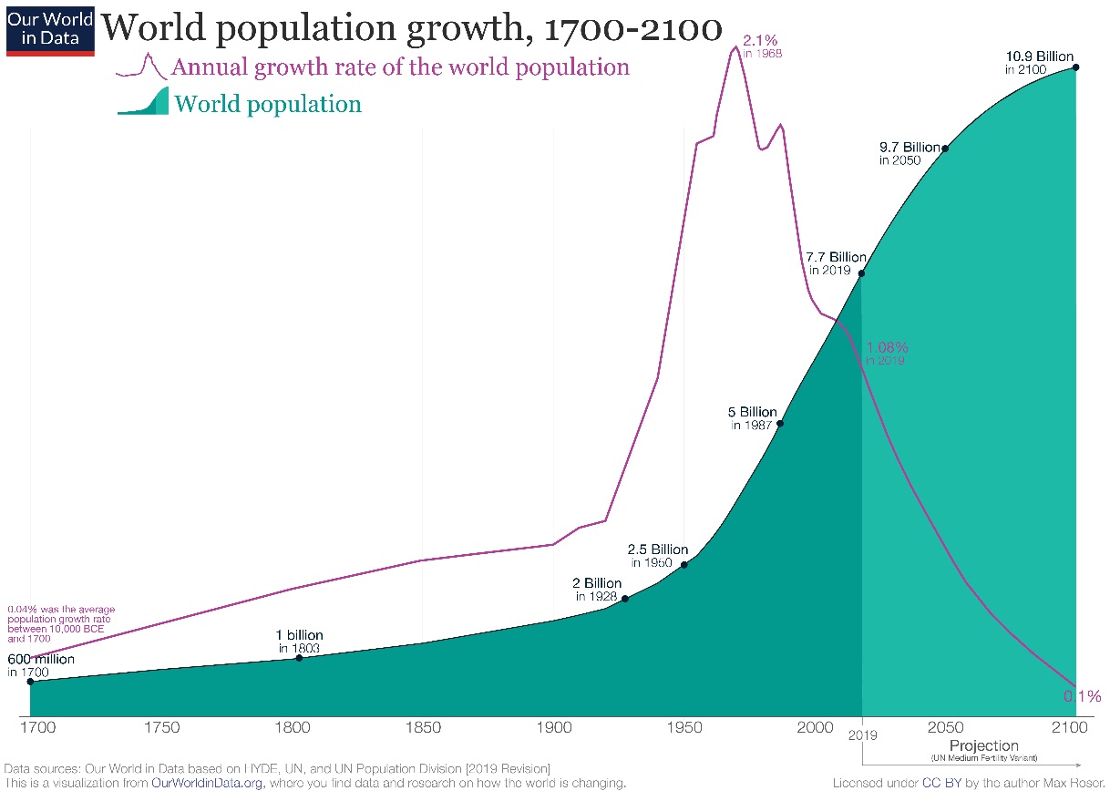
Food Stability
The world’s population continuously growing each year.
Need more food available to feed all people

Slide 7
Precision Agriculture
A concept in Agriculture Technology (AgTech) that involves
observation, measurement, and take proper actions in order to:
optimize productivity
reduce production costs
decrease environmental risks
https://eos.com/blog/precision-agriculture-from-concept-to-practice/
Productivity
Costs
Environmental
risks

Slide 8



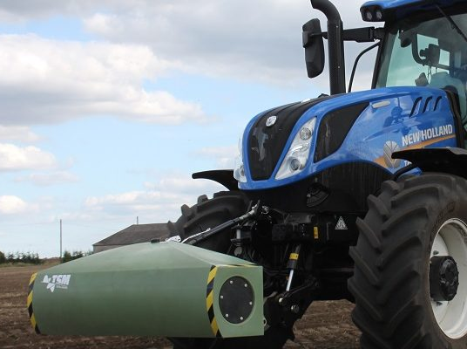
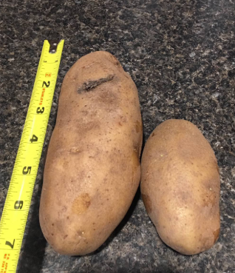
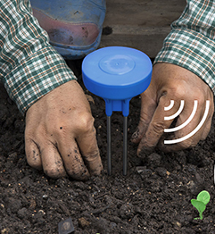
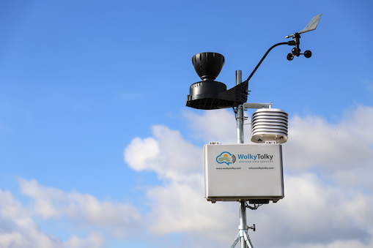

Collecting Data in Precision Agriculture
Winter
(Preparing)
Spring
(Seeding)
Autumn
(Harvesting)
Summer
(Following / Monitoring)
Data
analysis
Sensor
Crop sampling
Notes:
This figure shows an example of data collection activities in Precision Agriculture for one year.
In each season from preparing the field until harvesting the crops, farmers collect various data by using sensor devices. For example sensor devices collect data from environment (weather, soil nutrients, temperature, etc.)
Farmers need to observe the crops and measuring its growth regularly (by taking crop samples).
In autumn, farmers can use tractors to harvest the crops and the tractors record yield per area (yield / m2).
All collected data can be analyzed by researchers to support farmers in making proper decisions to improve productivity with efficient resource usage and eco-friendly manner.

Slide 9
Sensing
Sensing = observing and measuring activities to collect data
Based on data gathering method:
Manual sensing (labor-intensive activity)
e.g.: taking crop sample
Automated sensing (with the assistance of devices at a location)
e.g.: reading data from weather stations or sensor devices
Remote sensing (performed at a distance)
e.g: reading imagery data from satellite or drone
Notes:
The scope of the system in this project:
Handle manual and automated sensing data

Slide 10
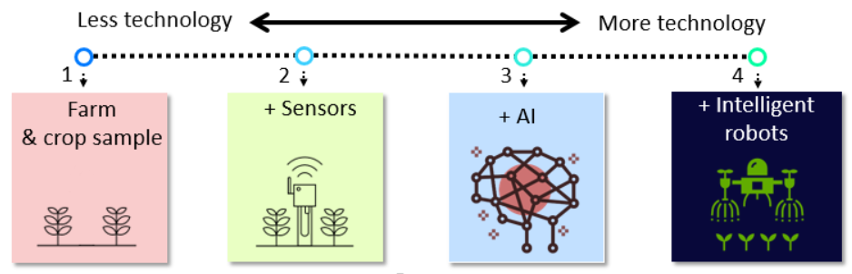
Application of Technology in Precision Agriculture
Target: Farmers who use manual and automated sensing to collect data
Notes:
The levels of technology usage in applying PA concept is shown in the figure.
The idea is originally from Paul.
Level 1: (traditional) farmers only have fields and crops.
They use manual sensing to collect crop samples.
The data is not analyzed.
Level 2: farmers have sensors
They use manual and automated sensing.
The data is not analyzed.
Level 3: farmers use AI to analyze their data.
Level 4: intelligent robots replace all the work in the fields.
Farmers do no need to perform manual sensing anymore.
The target users in the scope of this project:
only farmer levels 1 and 2
-> need to store their data
-> do not have tools or knowledge to perform data analysis

Slide 11
“… data storage for information discovery
in Precision Agriculture”
✓
What is Precision Agriculture?
What is data? What is information?
Are they same?

Slide 12
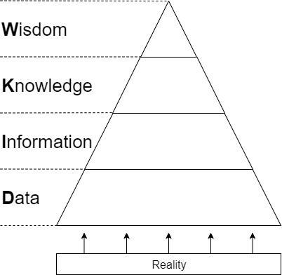
Data-Information-Knowledge-Wisdom (DIKW) Pyramid
→ “Why” behind the patterns for predicting the future
→ Rules or patterns
Data with meaning or context
Raw data (meaningless)
Rowley, J. (2007). The wisdom hierarchy: representations of the DIKW hierarchy. Journal of information science, 33(2), 163-180.
Notes:
The scope of the system in this project:
Handle manual and automated sensing data

Slide 13
An Example of DIKW
→ Predicted to rain tomorrow ➔ no irrigation is needed
Humidity ↑ and temperature ↓
likely make the cloud unable to hold the rain
Temperature: ↓ 3 degrees,
humidity : ↑ 10% in one hour
An array of numbers: {15.4, 16.2, 13.5, …}
Rowley, J. (2007). The wisdom hierarchy: representations of the DIKW hierarchy. Journal of information science, 33(2), 163-180.
Notes:
The scope of the system in this project:
Handle manual and automated sensing data

Slide 14
“… data storage for information discovery
in Precision Agriculture”
✓
What is Precision Agriculture?
✓
What is data? What is information?
Are they same?
Who will be the target users?

Slide 15
Target Users
Main target users:
Farmers
Utilizing farm data without vendor locked-in
Harvesting data from sensors
Saving time to explain their data to researchers
Students / Researchers
Having data to perform analysis

Slide 16
“… data storage for information discovery
in Precision Agriculture”
✓
What is Precision Agriculture?
✓
What is data? What is information?
Are they same?
✓
Who will be the target users?

Slide 17
Software System for Information Discovery
For information discovery:
Need context or metadata
Need to find required data efficiently
Context or metadata → provided by farmers
Finding data efficiently → structure data
Structuring data is needed!!

Slide 18
Investigating DIPPA
Initial Prototype: Data Integration Platform for Precision Agriculture (DIPPA)
Data integration in DIPPA:
→ Use Extract-Transform-Load (ETL) process
→ Need solid knowledge of data sources and internal database schemas to structure the data
System maintainer : difficult to support various data from farmers and sensor providers
Farmers : learn database schemas?
Some data in DIPPA lacked context or metadata
→ Hindering researchers to perform data analysis
B. Enkhtaivan. DIPPA : Data integration platform for precision agriculture, Eindhoven University of Technology, PDEng Thesis, October 2018.

Slide 19
Challenges
Challenges addressed in this project:
Integrating sensing data with diverse data structures
Providing enough metadata for researchers
Notes:
Who should integrate sensing data in the system?
Farmer or system maintainer?
Who should provide metadata?
How to provide metadata?

Slide 20
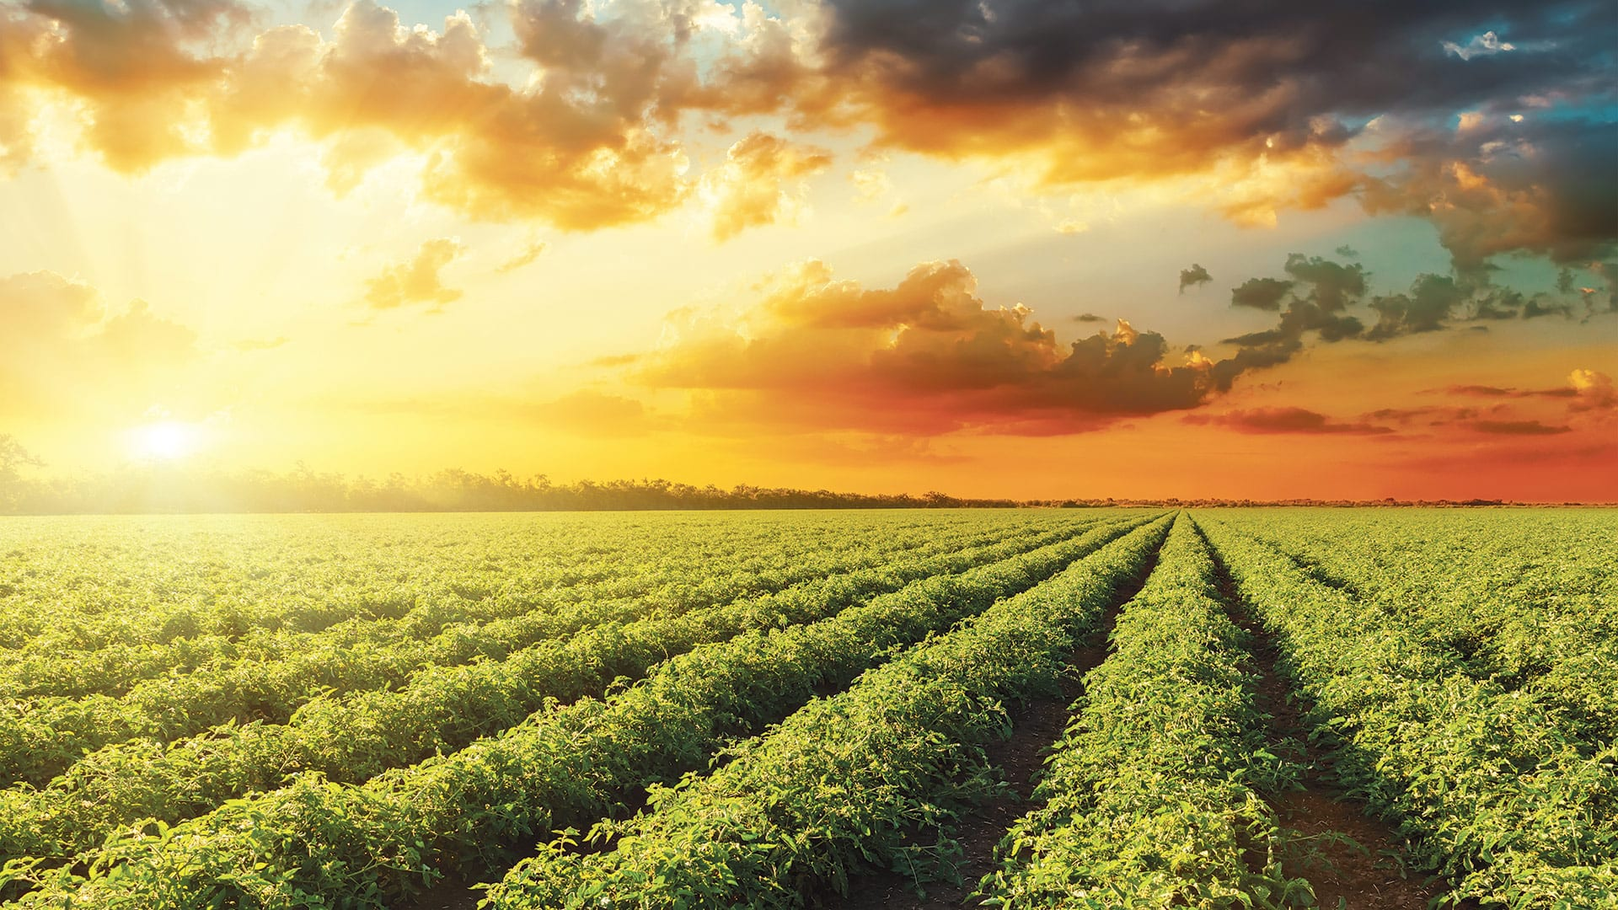
Project Goal

Slide 21
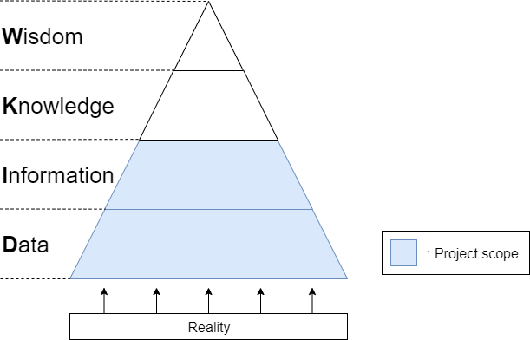
Projection to DIKW Pyramid
Notes:
The scope of the system in this project:
Handle manual and automated sensing data

Slide 22
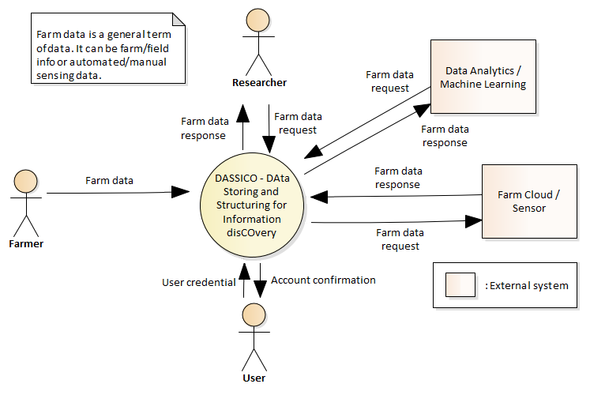
Project Goal
To have a software system to store and structure sensing data for information discovery
Notes:
Why structuring data?
It is possible to store data in file system as raw data, but it might be difficult to find particular data in the file that researchers / analytics tool need.
The file system is useful if you are looking for a particular file. OS maintains index for searching files, but the content in the file is not indexed.
Purpose of structuring the data:
-> Structuring the data allows the system to find requested data efficiently to satisfy business requests from data consumers. (Chapter 6.1)

Slide 23
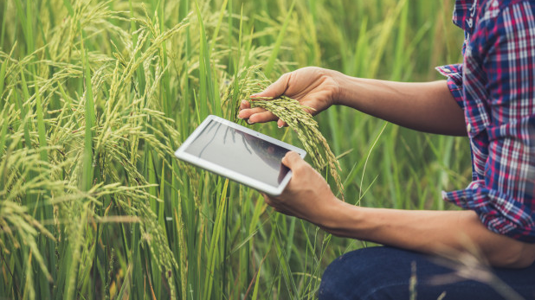
System Design

Slide 24
Key Design Criteria
Maintainability:
Having modular design (NFR.MA.01)
Extending functionalities with minimal impact on other components (NFR.MA.02)
Reliability:
Providing services despite the presence of software faults at other unrelated services (NFR.RE.01)
Performance:
When data request is received, the system gives feedback within two seconds (NFR.PE.01)
Notes:
Usability, Compatibility, Security, and Reliability are also high priority requirements.
But they impact more on component levels, not in architectural level.

Slide 25
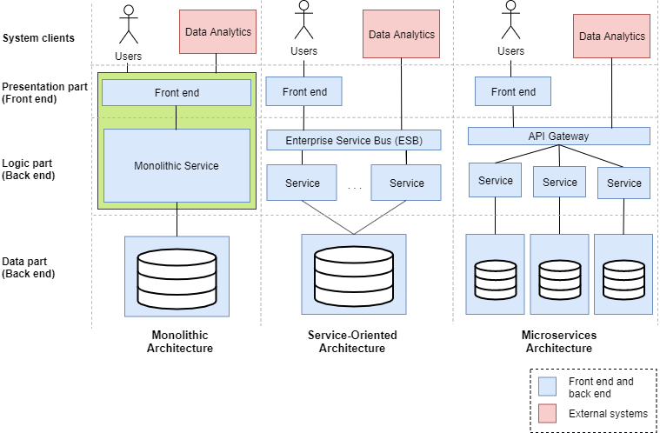
Architecture Pattern Alternatives

Slide 26
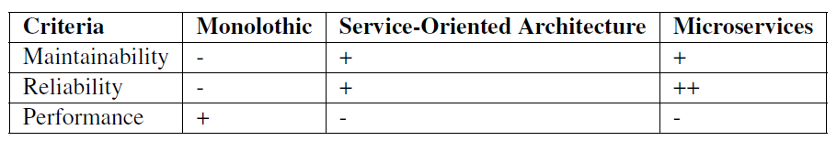
Comparison of the architecture alternatives
Microservice architecture pattern was chosen due to its benefits in maintainability and reliability.
To mitigate performance issue, some tactics were addressed.

Slide 27
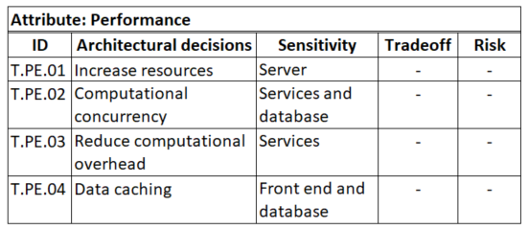
Performance Tactics

Slide 28
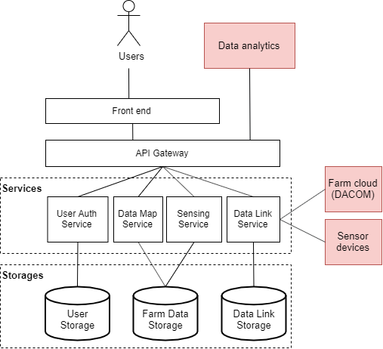
DASSICO Design
: external system

Slide 29
Services
A set of functional requirements of the system were grouped into several services:
User Auth service
For security (user authentication and authorization)
Data Map service
For managing the metadata of sensing data
Sensing service
For managing general farm data and sensing data
Data Link service
For managing connections with farm clouds and/or sensor devices

Slide 30
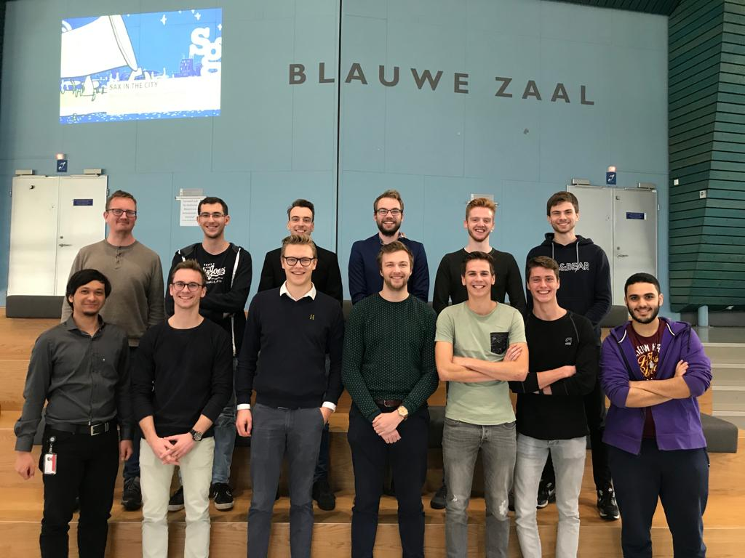
Collaboration with SEP Students
Software Engineering Project (SEP) consisting of 11 Computer Science BSc students (3rd year) from 2 September until 8 November 2019.
DASSICO architecture design provided by the PDEng trainee.
SEP students designed and developed subset of the system.

Slide 31
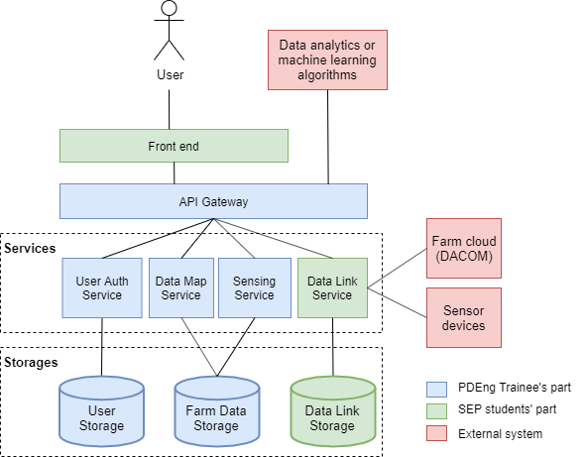
Sharing Responsibility

Slide 32
Addressing Project Challenges
To address a challenge:
Integrating sensing data with diverse data structures
Metadata-based ETL
Data integrators (farmers) only needs:
Sensing data
Metadata
No need to know internal database schema of DASSICO

Slide 33
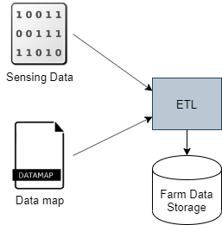
Metadata-based ETL
Using metadata provided by farmers to integrate sensing data
Data map = metadata of the sensing data to map it to proper database tables (destination)
ETL = Extract-Transform-Load process

Slide 34
Data Map
Containing metadata of sensing data that describes:
Object being observed
Parameter or characteristic of the object to observe
Measurement unit
Observation time
Geo location of the observation
Measuring equipment or sensor
Data Map
Observed object
Measurement unit
Observation time
Observation location
Parameter
Equipment

Slide 35
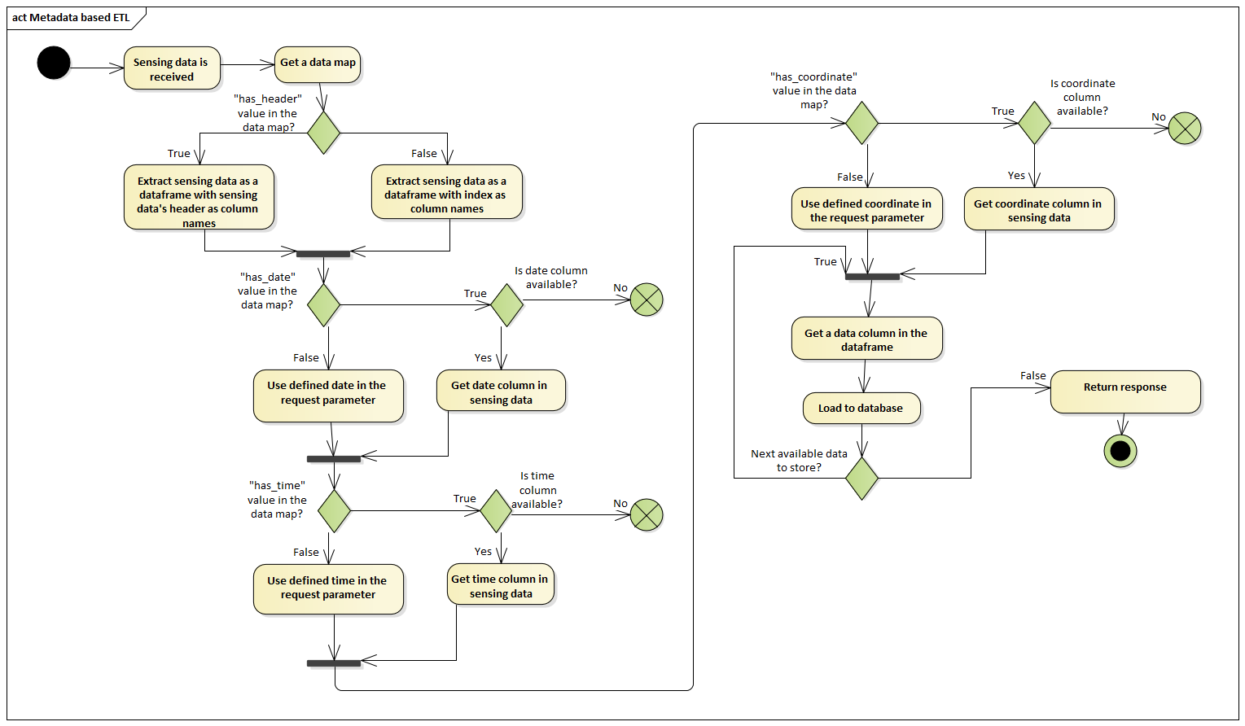
Metadata-based ETL: Activity Diagram
Data extraction
Data checking
Data loading

Slide 36
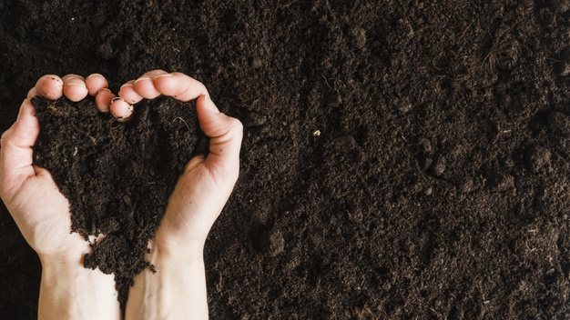
Implementation

Slide 37
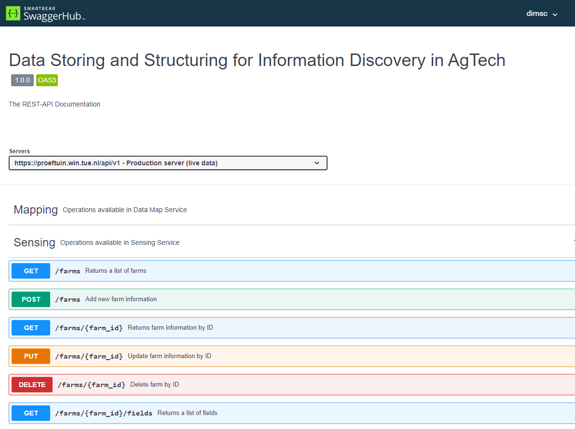
API Documentation in SwaggerHub

Slide 38
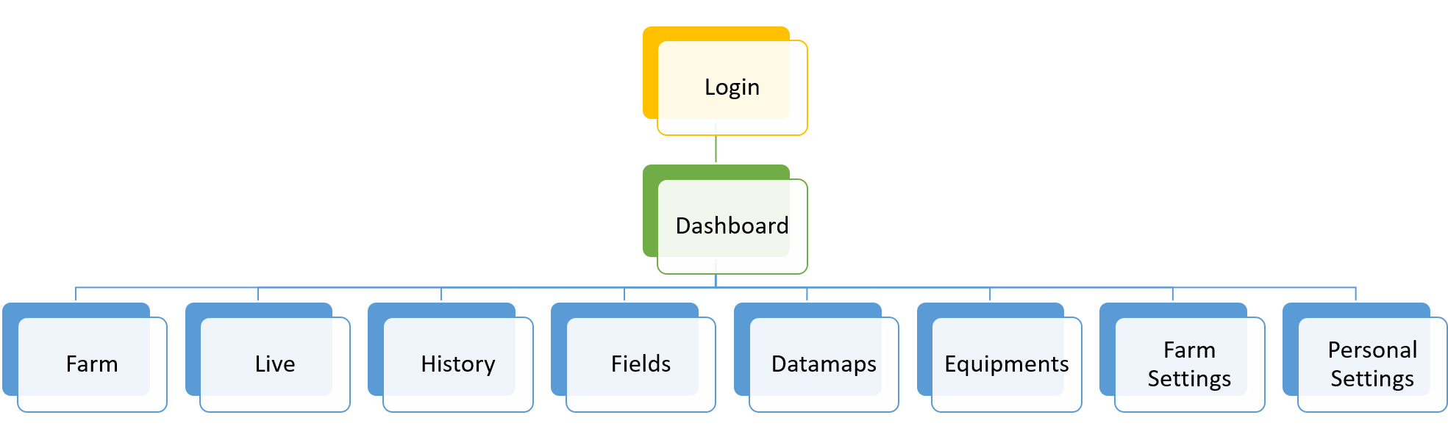
Page Views in Front-end

Slide 39
DEMO

Slide 40
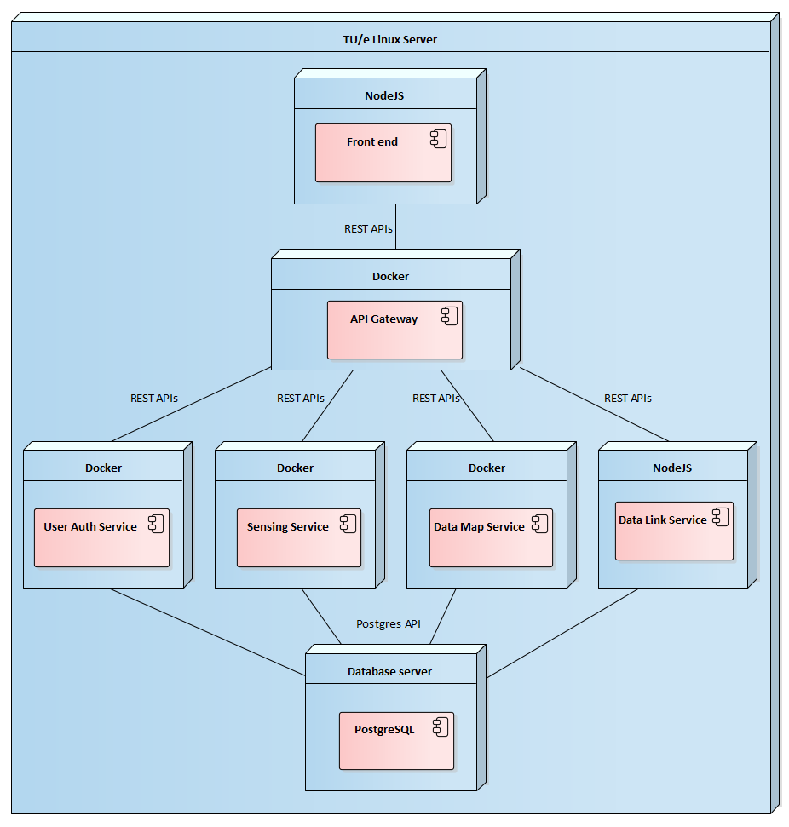
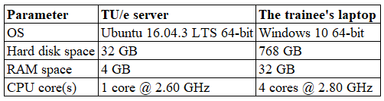
Deployment View

Slide 41
Verification and Validation
Verification
Unit tests
Integration tests together with SEP students
Validation
Demo and discussion with supervisors
User validation planned in December 2019

Slide 42
Performance Test
Due to limited time in the project, the performance tests were conducted to:
Loading time of page views by SEP students
Loading test with multiple concurrent requests to the back end

Slide 43
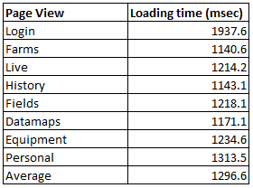
Performance Test – Page Loading
The performance of loading page views can be seen below [SEP – Software Design Document]:

Slide 44
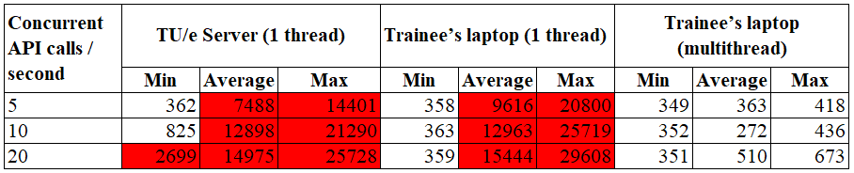
Load Test
Purpose: determining the stability and robustness of the system
Tested feature: user login
Running system services with multithreading can improve system performance.
In millisecond unit

Slide 45
Machine Specification

Slide 46
Project Management

Slide 47
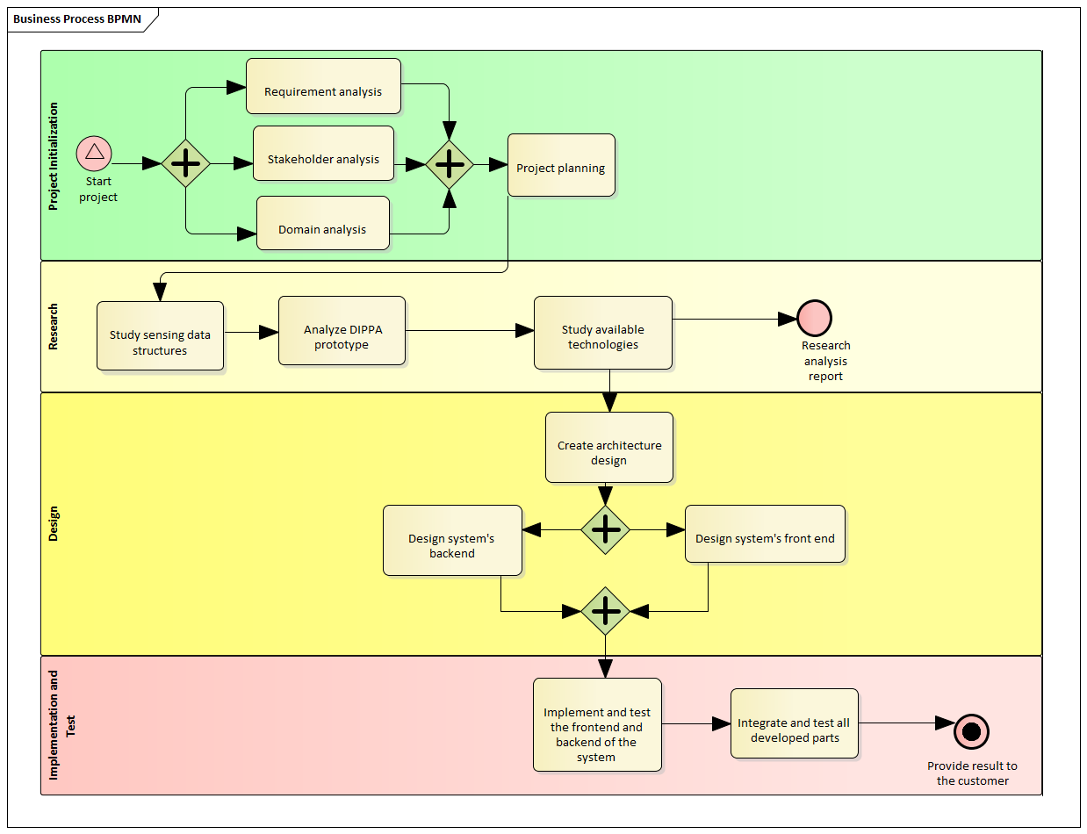
Project Management: Process Model
Agile methodology
Waterfall methodology for Research phase
→ Defined questions to be researched during fixed period of time

Slide 48
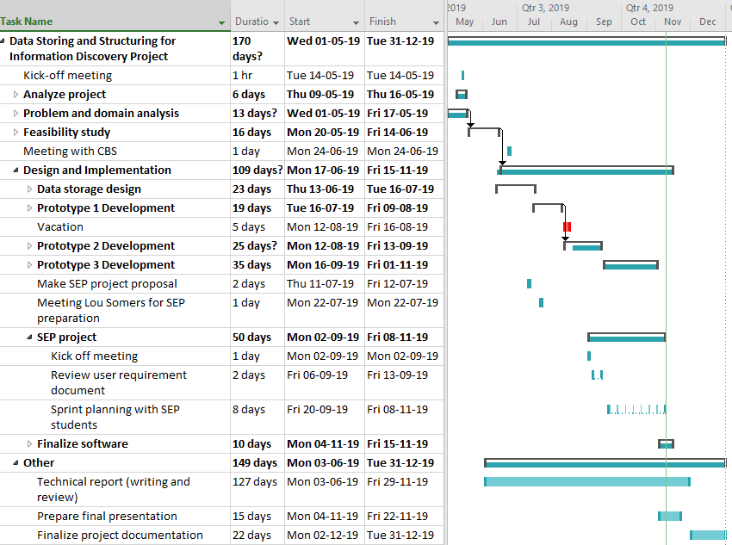
Project Management: Project Activity Plan
Reviewed and updated in every 1-week sprint planning
Discussed during weekly progress meetings and Project Steering Group (PSG) meetings

Slide 49
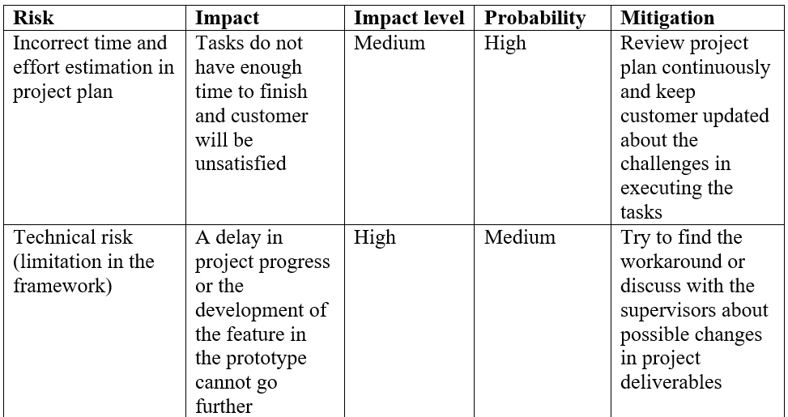
Risk Analysis

Slide 50
Conclusions

Slide 51
Conclusions
DASSICO system developed to integrate sensing data with various structures
Metadata-based ETL design allowing farmers to integrate data easily only by providing metadata
The provided metadata for the ETL process benefiting researchers for performing data analysis
The design of DASSICO enabling evolution of the system to add new functionalities or services easily

Slide 52
Future Work
Performance improvement needed
Connecting to farm clouds and more sensor devices
Integrating remote sensing data

Slide 53
Lessons Learned
Communication is the key
Improved managerial skills
Important to define scope as soon as possible

Slide 54
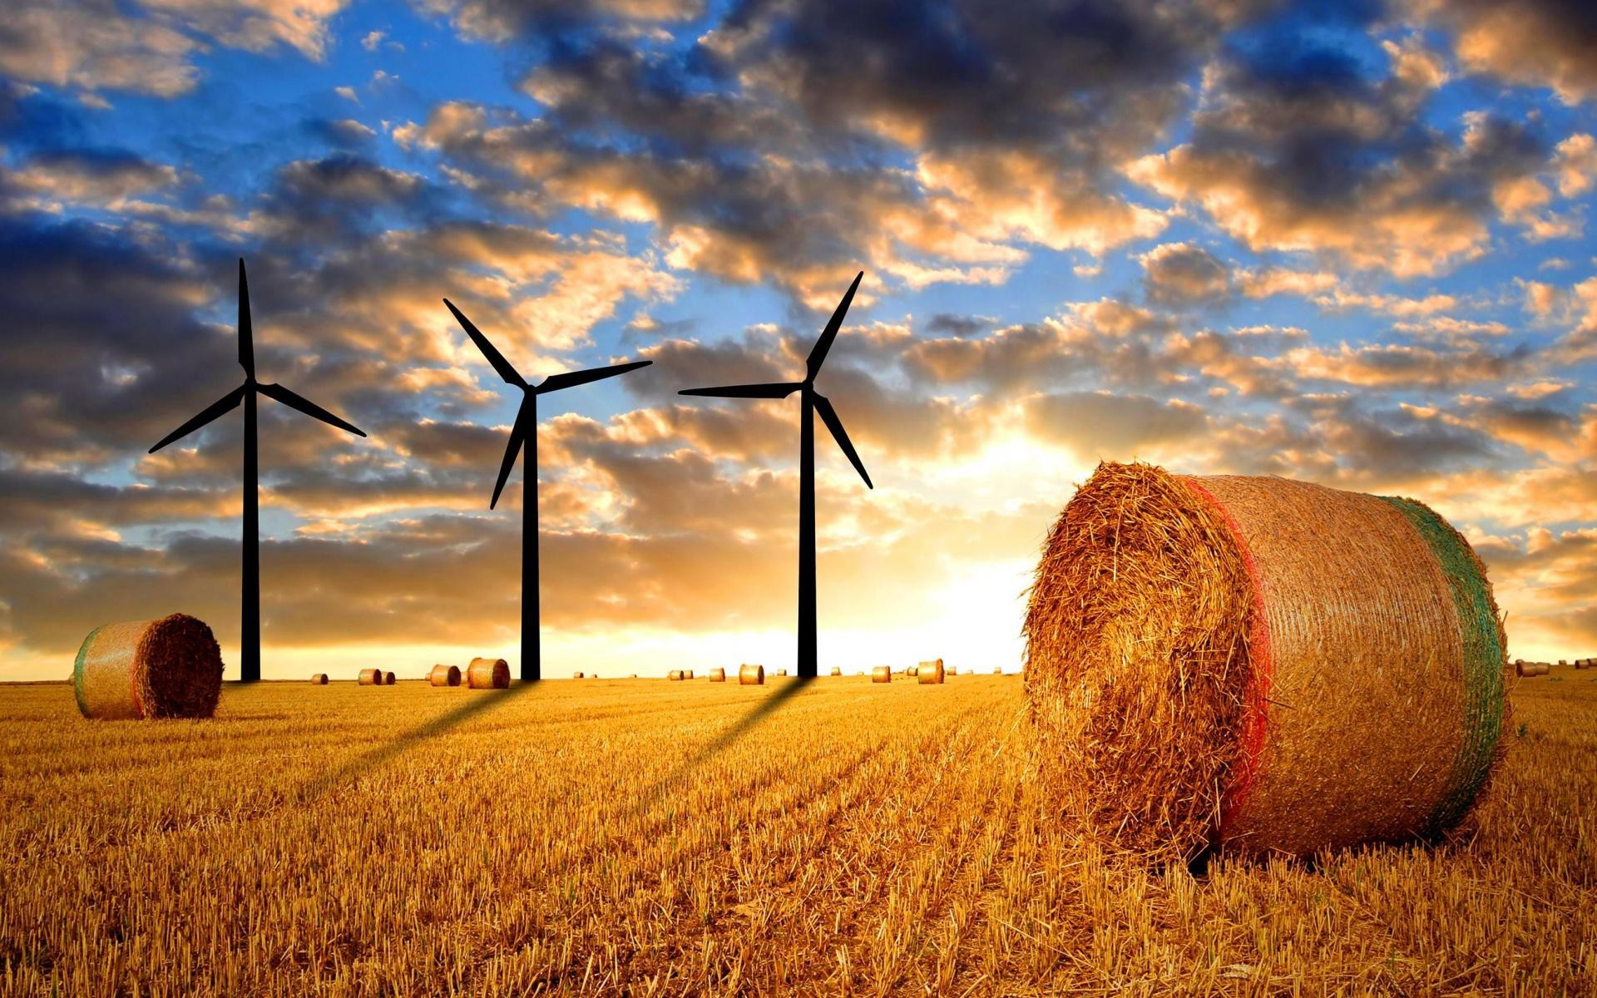


Thank you

Slide 55
Back-up Slides

Slide 56
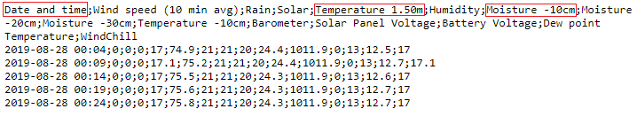
Sensing Data

Slide 57
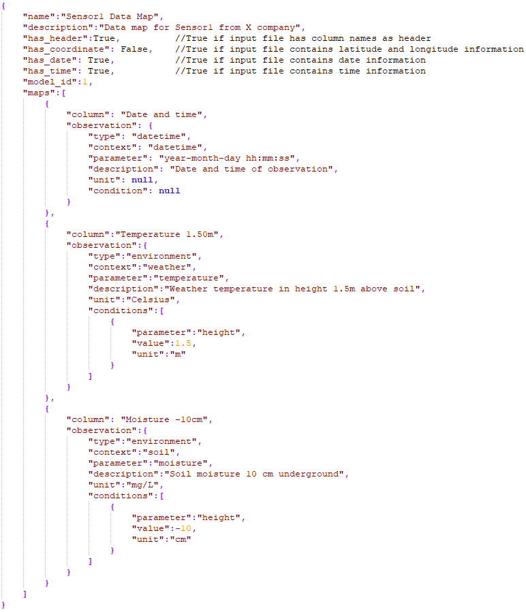
Datamap

Slide 58
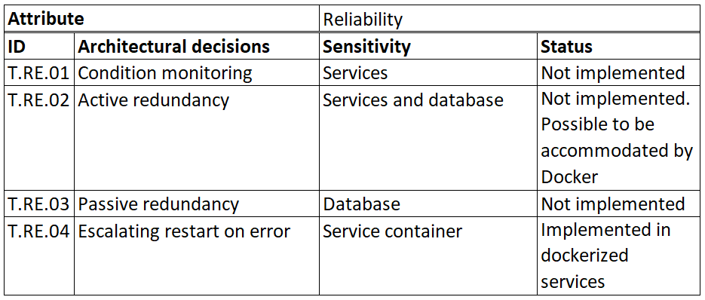
Reliability Tactics

Slide 59
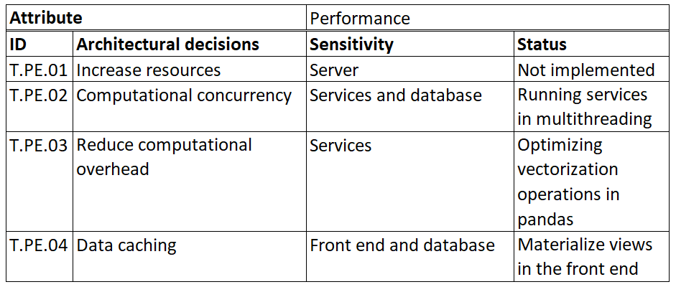
Performance Tactics

Slide 60
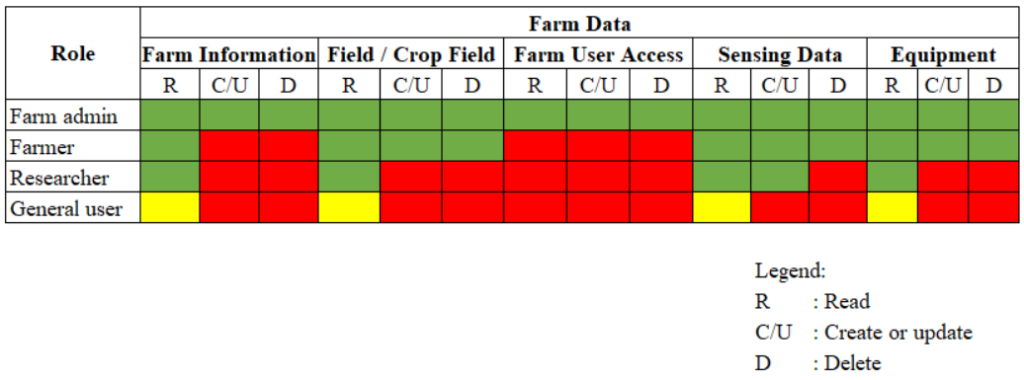
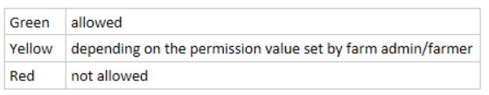
Role-based Access Permission for Security

Slide 61
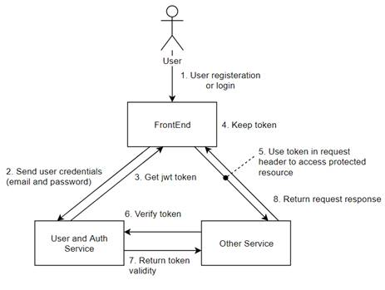
JSON Web Token for Identifying User Access
For protecting services from unauthorized access, JWT token is used.
JWT token is created during user login in User and Auth Service.
Impacts on the system:
+ Protect services and restricted resource from unauthorized access
+ Enable possibility for external systems to access services directly by providing correct credential in the future (out-of scope for this project)
- Need more time to validate and check access permission for each request to the services

Slide 62
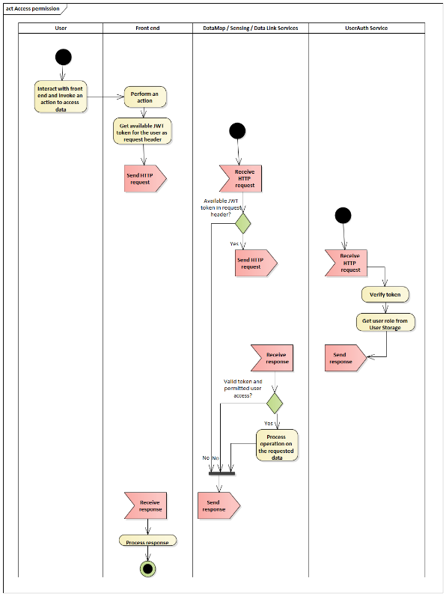
OAuth with JWT for Security

Slide 63
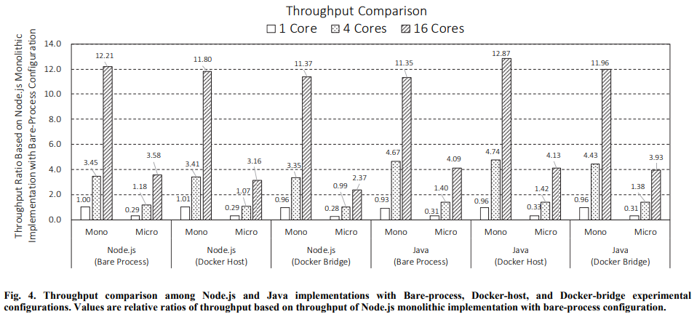
Monolithic vs Microservice (Performance)
Ueda, T., Nakaike, T., & Ohara, M. (2016, September). Workload characterization for microservices. In 2016 IEEE international symposium on workload characterization (IISWC) (pp. 1-10). IEEE.
Notes:
Throughput – indicates the number of transactions per second an application can handle

Slide 64
Compatibility
Compatibility requirement affects API Gateway to exchange information with external systems.
API Gateway handles incoming requests from clients and route them to appropriate services.

Slide 65
SOAP vs REST for Compatibility
Parameter | REST API | SOAP API
Data format | + Many data formats including plain text, HTML, XML, and JSON | - Only XML
Bandwidth | + Requires less resources and is lightweight | - Requires more resources and bandwidth that can affect performance
Data cache | + Can be cached to provide better performance | - Cannot be cached
Security | o SSL and HTTPS | o WS-security and SSL
Reliable messaging functionality | - No standard messaging system and only addressing communication failures by retrying | + Built-in successful/retry logic

Slide 66
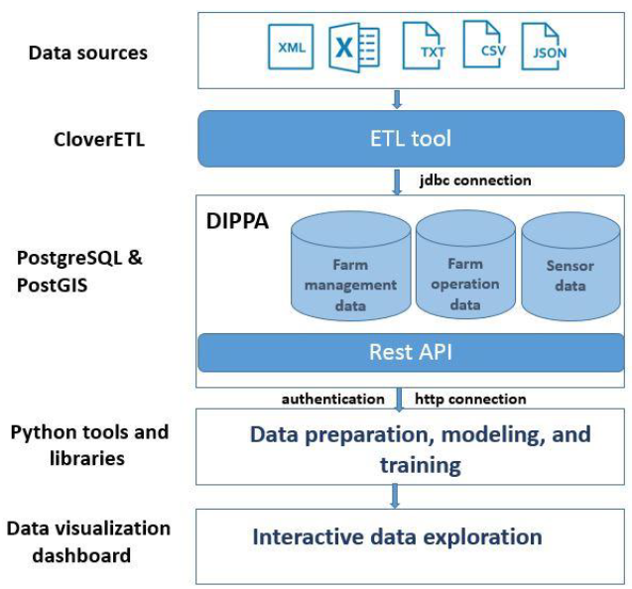
Extract-Transform-Load (ETL) tasks to store and structure diverse data from many sources
Creating ETL tasks needs solid knowledge of data sources and internal database schemas in DIPPA.
Reference: B. Enkhtaivan. DIPPA : Data integration platform for precision agriculture, Eindhoven University of Technology, PDEng Thesis, October 2018.
Notes:
It is rather challenging to create ETL tasks for farmers, who have domain knowledge in agriculture, to learn database schemas or for software engineers to understand farm data owned by each farmer.
Many farmers in the world
Many sensors produced to monitor crops or environments
-> difficult for software engineers to structure different data schemas from all of them

Slide 67
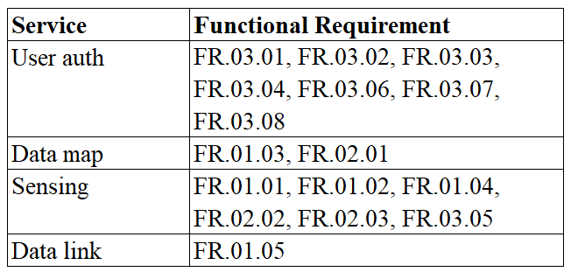
Services-Functional Requirement Matrix

Slide 68
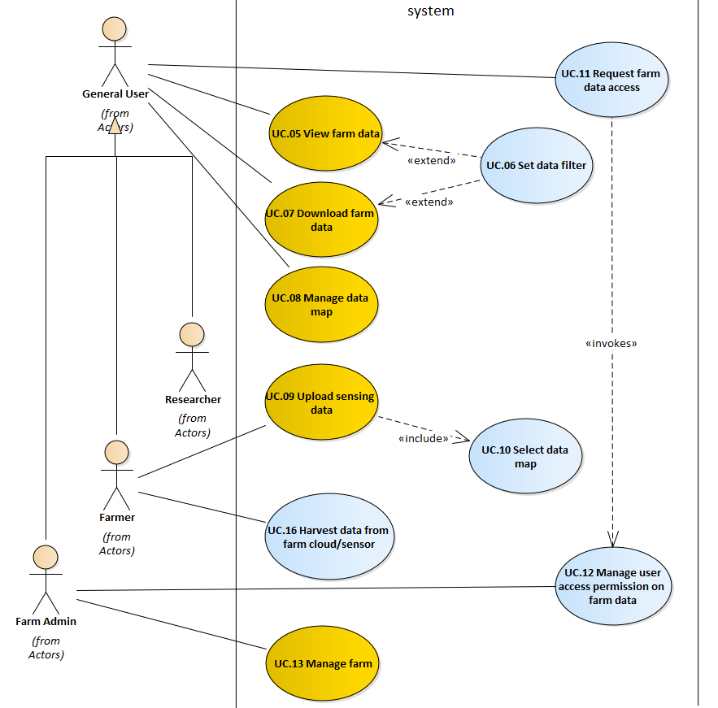
Use Cases
Main use cases for the software system:
View farm data
Download farm data
Upload sensing data
Manage farm
Notes:
The scope of the system in this project:
Handle manual and automated sensing data

Slide 69
Structuring Data for Information Discovery
Information discovery ➔ need to find data efficiently
Options:
Storing sensing data as raw data in file system
Difficult to find particular data contained in the files
Storing and structuring the data in database
Required data can be queried efficiently

Slide 70
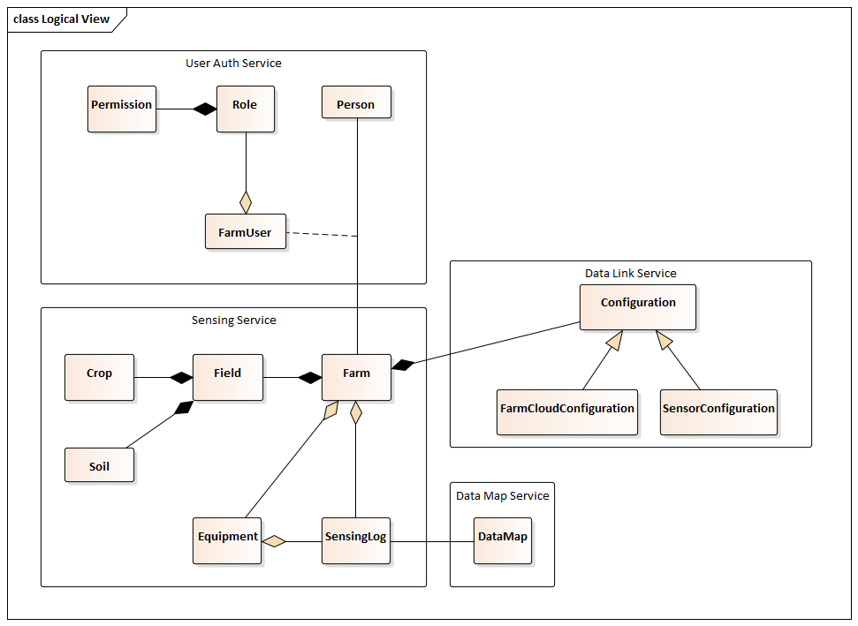
Domain Model

Slide 71
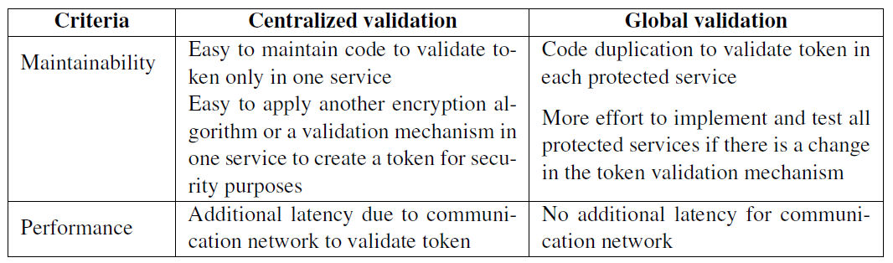
Centralized vs Global Validation

Slide 72
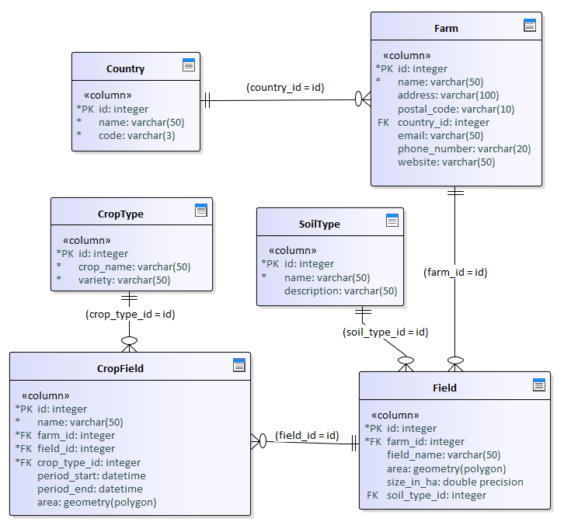



Data Models
Farm data model
User data model
Sensing data model
Data map model

Slide 73
User Data Model

Slide 74
Farm Data Model

Slide 75
Sensing Data Model

Slide 76
Data Map Model

Slide 77

Data-Link Data Model

Slide 78

Client-Server Model
An application of data storage and its services use client-server model.
That is characterized by:
Multiple clients can request services from the server
Clients initiate communication session with the server
Notes:
Mention another option in report: peer-to-peer

Slide 79
Alternative: Peer-to-peer Model
An application of data storage and its services use client-server model.
That is characterized by:
Multiple clients can request services from the server
Clients initiate communication session with the server
Notes:
Mention another option in report: peer-to-peer

Slide 80


Slide 81
The server hosts back-end system including
API gateway
Service layer
Data storage
Notes:
Explain rationales per sections/layers

